Slide 1
Traffic Analysis
07
Kai Bu
kaibu@zju.edu.cn
http://list.zju.edu.cn/kaibu/netsec2022

Slide 2
Traffic Analysis
filter malicious traffic

Slide 3
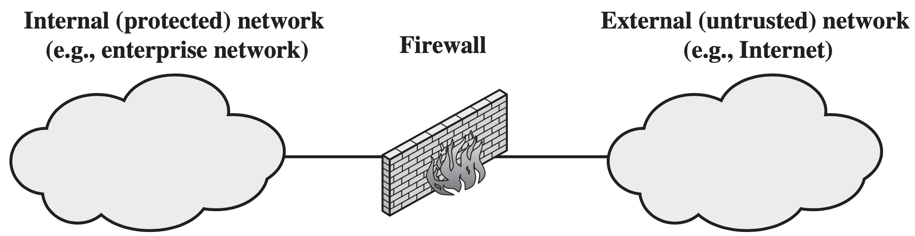
Firewall
Form a barrier through which the triffic going in each direction must pass
Use firewall security policy to dictate which traffic is authorized to pass in each direction

Slide 4
Design Goals
All traffic from inside to outside, and vice versa, must pass through the firewall.
Only authorized traffic, as defined by the local security policy, will be allowed to pass.
The firewall itself is immune to penetration.

Slide 5
Design Techniques
Service Control
Direction Control
User Control
Behavior Control

Slide 6
Service Control
Service Control determine service types that can be accessed, inbound or outbound

Slide 7
Service Control
Service Control determine service types that can be accessed, inbound or outbound
Filter traffic on the basis of IP address, protocol, or port number
Provide proxy software that receives and interprets each service requet before passing it on
Host the server software itself, such as Web or Email service

Slide 8
Direction Control
Direction Control determine the direction in which particular service requests may be initiated and allowed to flow through the firewall

Slide 9
User Control
User Control control access to a service according to which user is attempting to access it

Slide 10
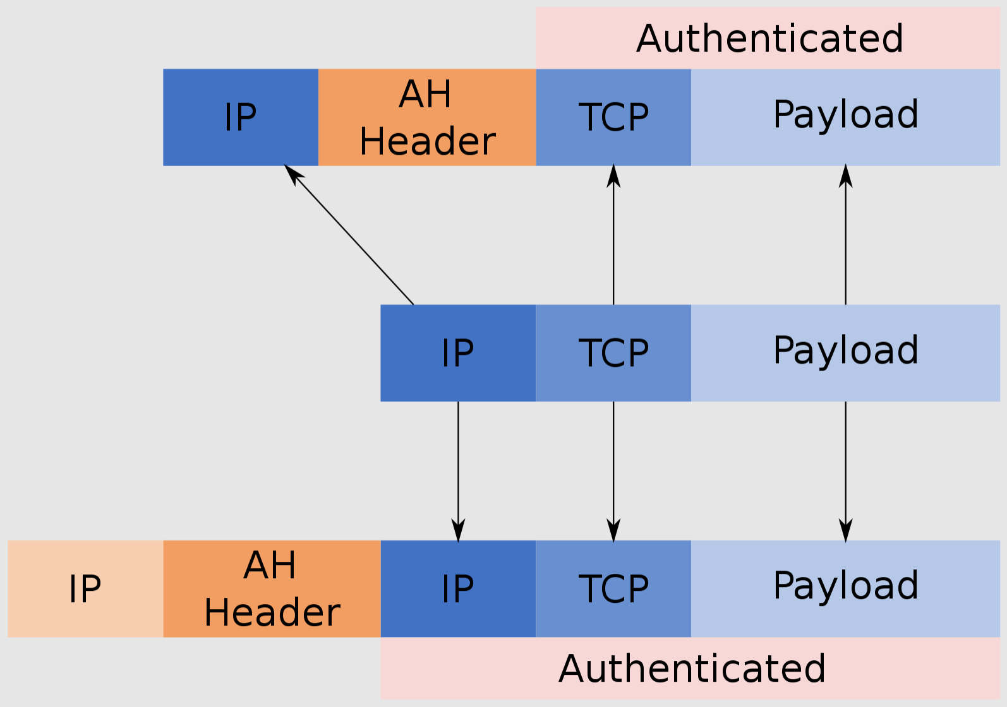
User Control
User Control control access to a service according to which user is attempting to access it
Typically apply to local users
Also apply to external users via secure authentication technology (e.g., IPsec Authentication Header)
https://en.wikipedia.org/wiki/IPsec
Notes:
https://en.wikipedia.org/wiki/IPsec

Slide 11
Behavior Control
Behavior Control control how particular services are used

Slide 12
Behavior Control
Behavior Control control how particular services are used
E.g., filter E-mail to eliminate spam, or enable external access to only a portion of the information on a local Web server

Slide 13
Types of Firewalls?
packet filtering firewall
stateful inspection firewall
application proxy firewall
circuit-level proxy firewall

Slide 14
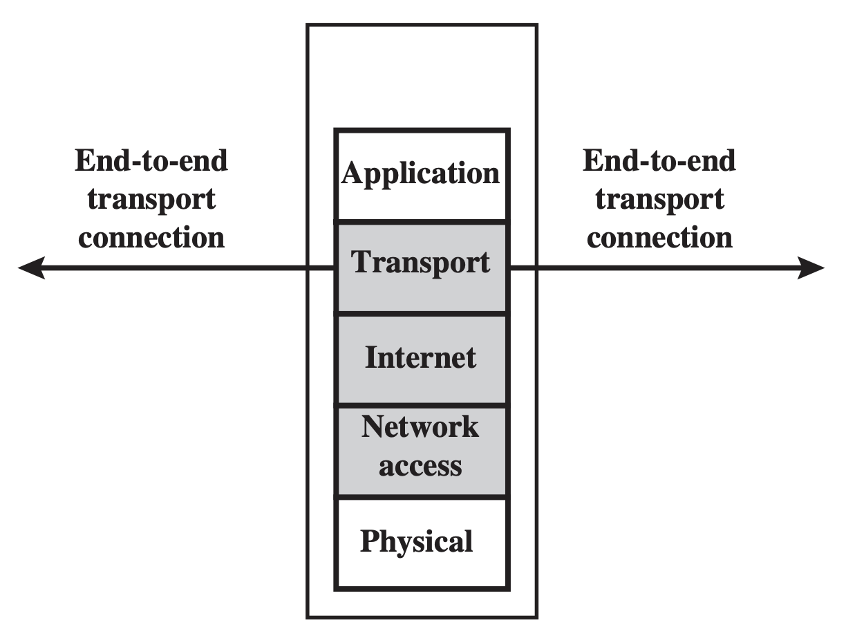
Packet Filtering Firewall
Apply a set of rules to each incoming and outgoing IP packet
Forward or discard the packet

Slide 15
Packet Filtering Firewall
Apply a set of rules to each incoming and outgoing IP packet
Forward or discard the packet
firewall:
interface
packet header fields:
source IP/port
destination IP/port
protocol

Slide 16
Packet Filtering Firewall
Apply a set of rules to each incoming and outgoing IP packet
Forward or discard the packet
if no match
default discard, or
default forward
Notes:
The default discard policy is more conservative. Initially, everything is blocked, and services must be added on a case-by-case basis. This policy is more visible to users, who are more likely to see the firewall as a hindrance. However, this is the policy likely to be preferred by businesses and government organizations. Further, visibility to users diminishes as rules are created. The default for- ward policy increases ease of use for end users but provides reduced security; the security administrator must, in essence, react to each new security threat as it becomes known. This policy may be used by generally more open organizations, such as universities.

Slide 17
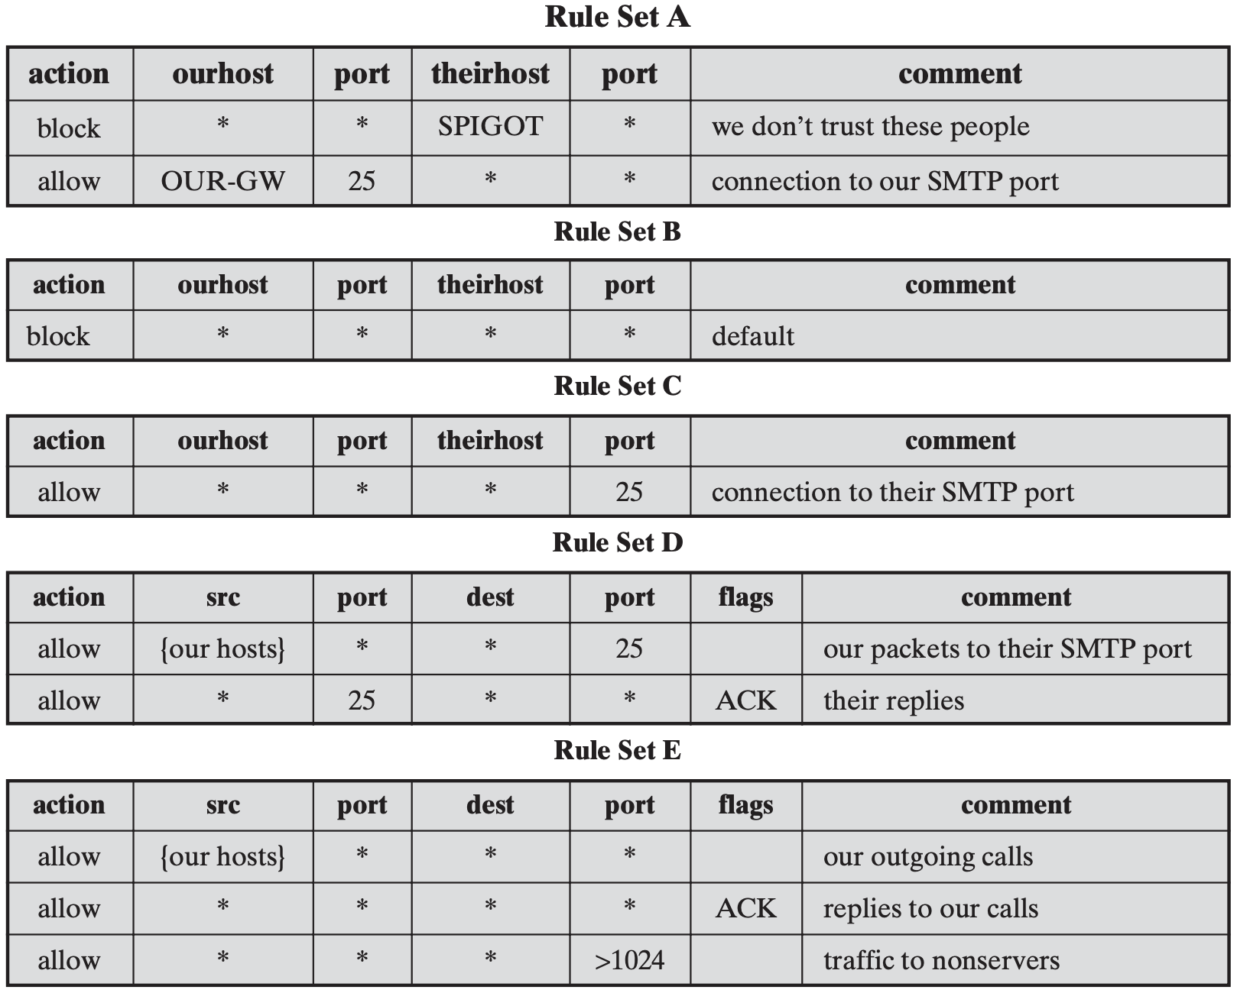
if no match
default discard

Slide 18
Packet Filtering Firewall
Make filtering decisions on an individual packet basis
Consider no higher-layer context
Notes:
The default discard policy is more conservative. Initially, everything is blocked, and services must be added on a case-by-case basis. This policy is more visible to users, who are more likely to see the firewall as a hindrance. However, this is the policy likely to be preferred by businesses and government organizations. Further, visibility to users diminishes as rules are created. The default for- ward policy increases ease of use for end users but provides reduced security; the security administrator must, in essence, react to each new security threat as it becomes known. This policy may be used by generally more open organizations, such as universities.

Slide 19
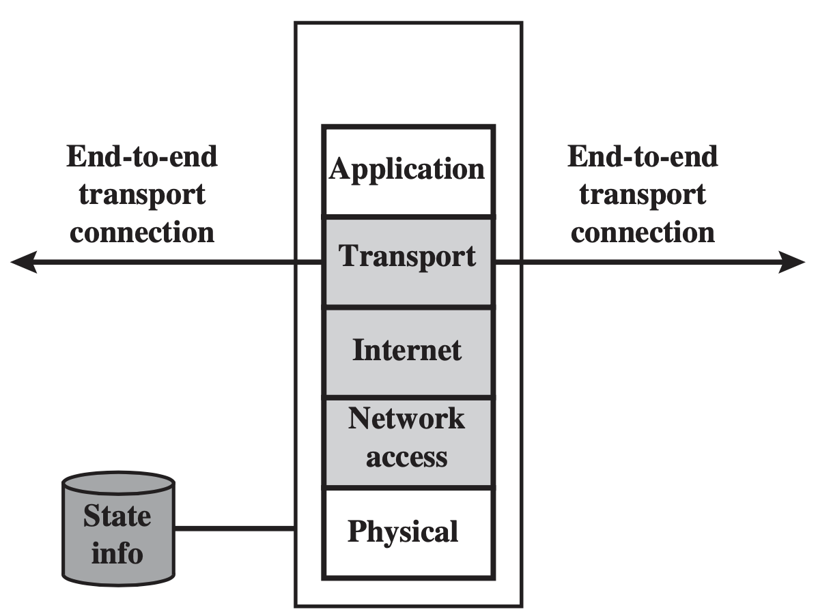

Stateful Inspection Firewall
Both packets and their context are examined by the firewall

Slide 20
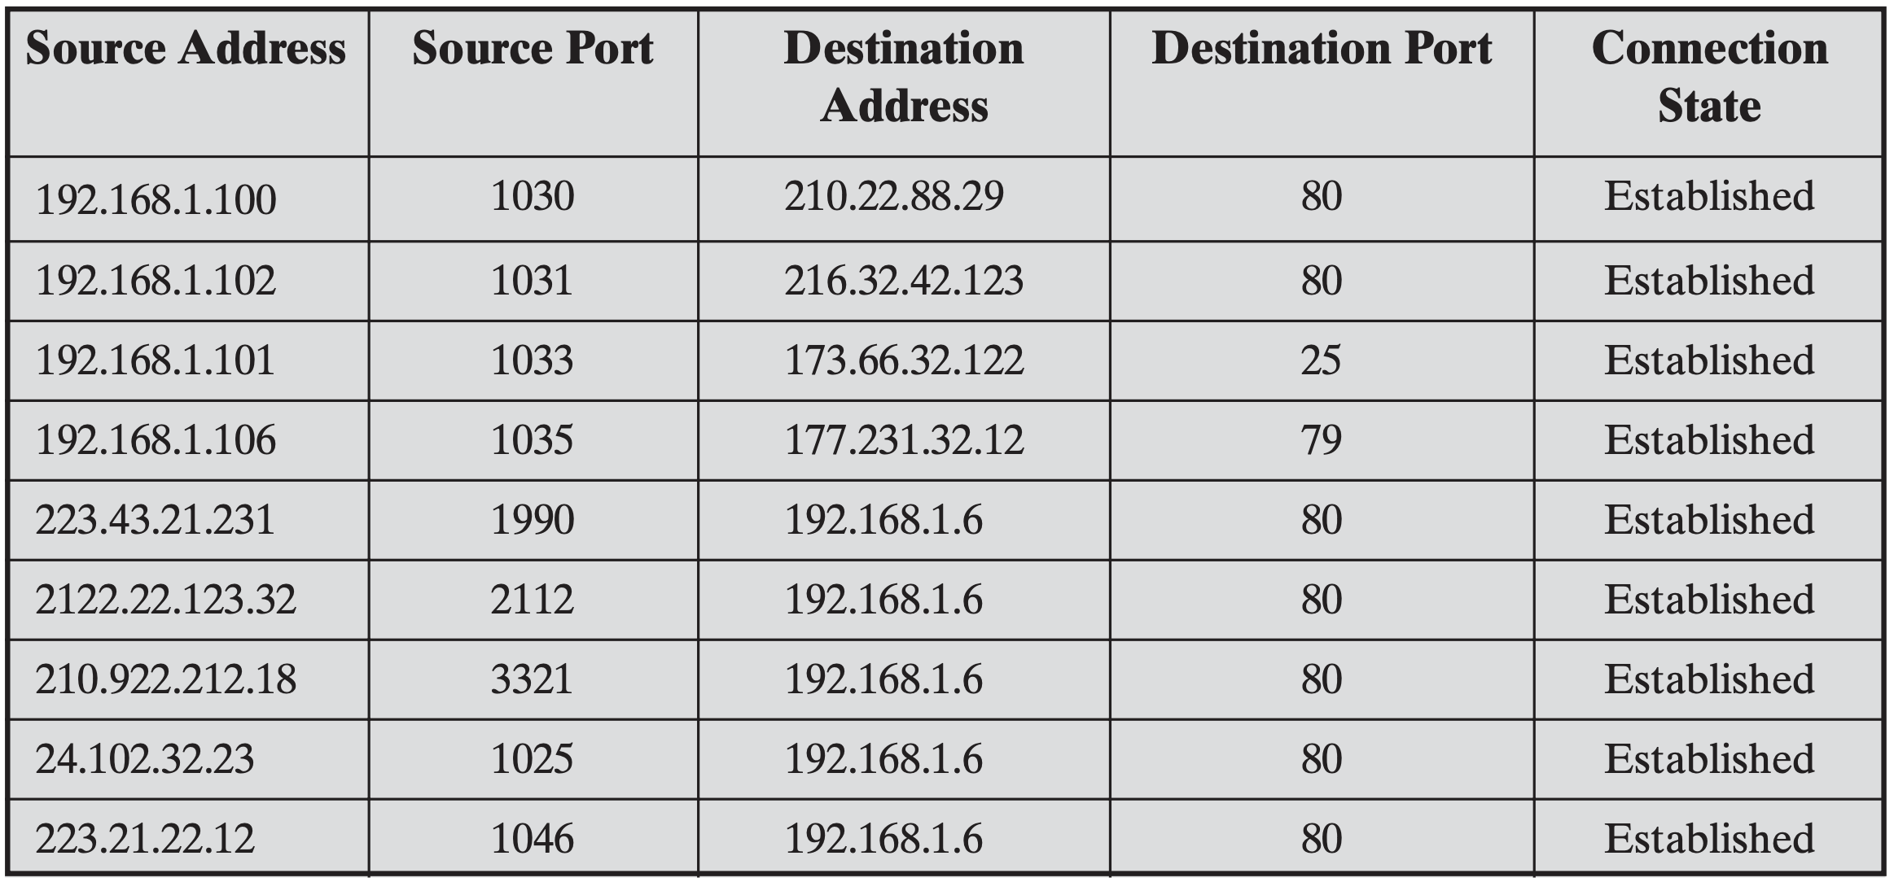
Stateful Inspection Firewall
Both packets and their context are examined by the firewall

Slide 21
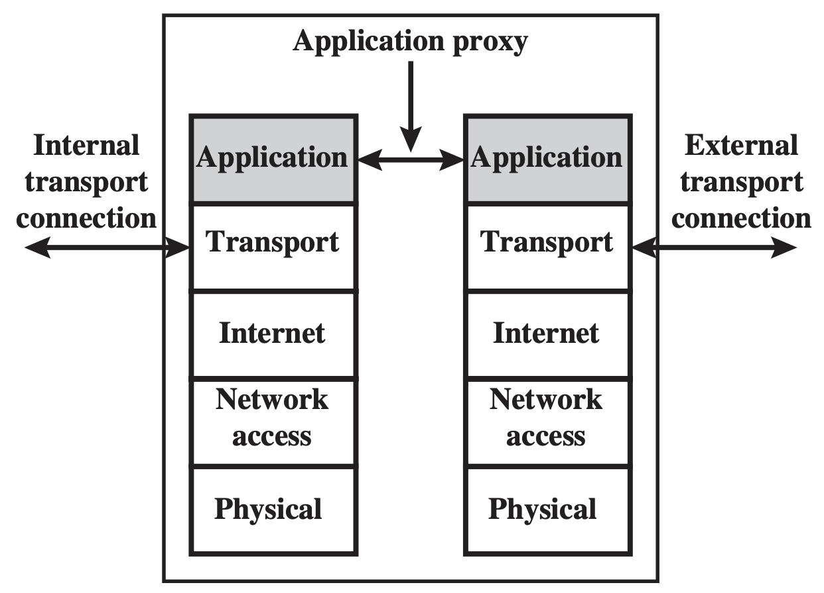
Application Proxy Firewall
Application-Level Gateway
Act as a relay of application-level traffic

Slide 22
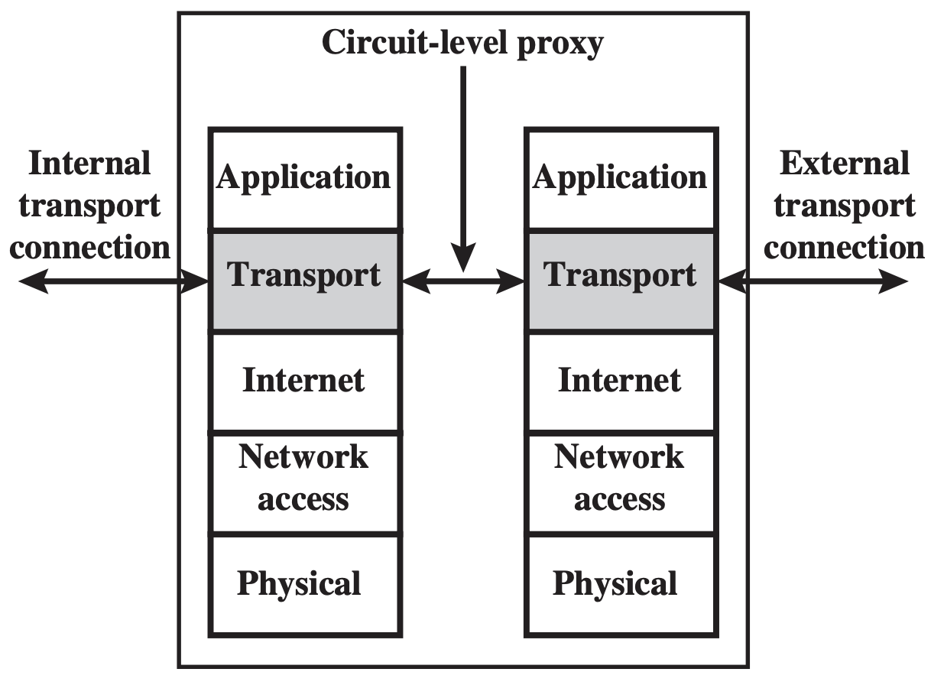
Circuit-Level Proxy Firewall
Circuit-Level Gateway
Act as a relay of TCP segments without examining the contents

Slide 23
where firewalls stand?
DMZ networks
virtual private networks
distributed firewalls

Slide 24
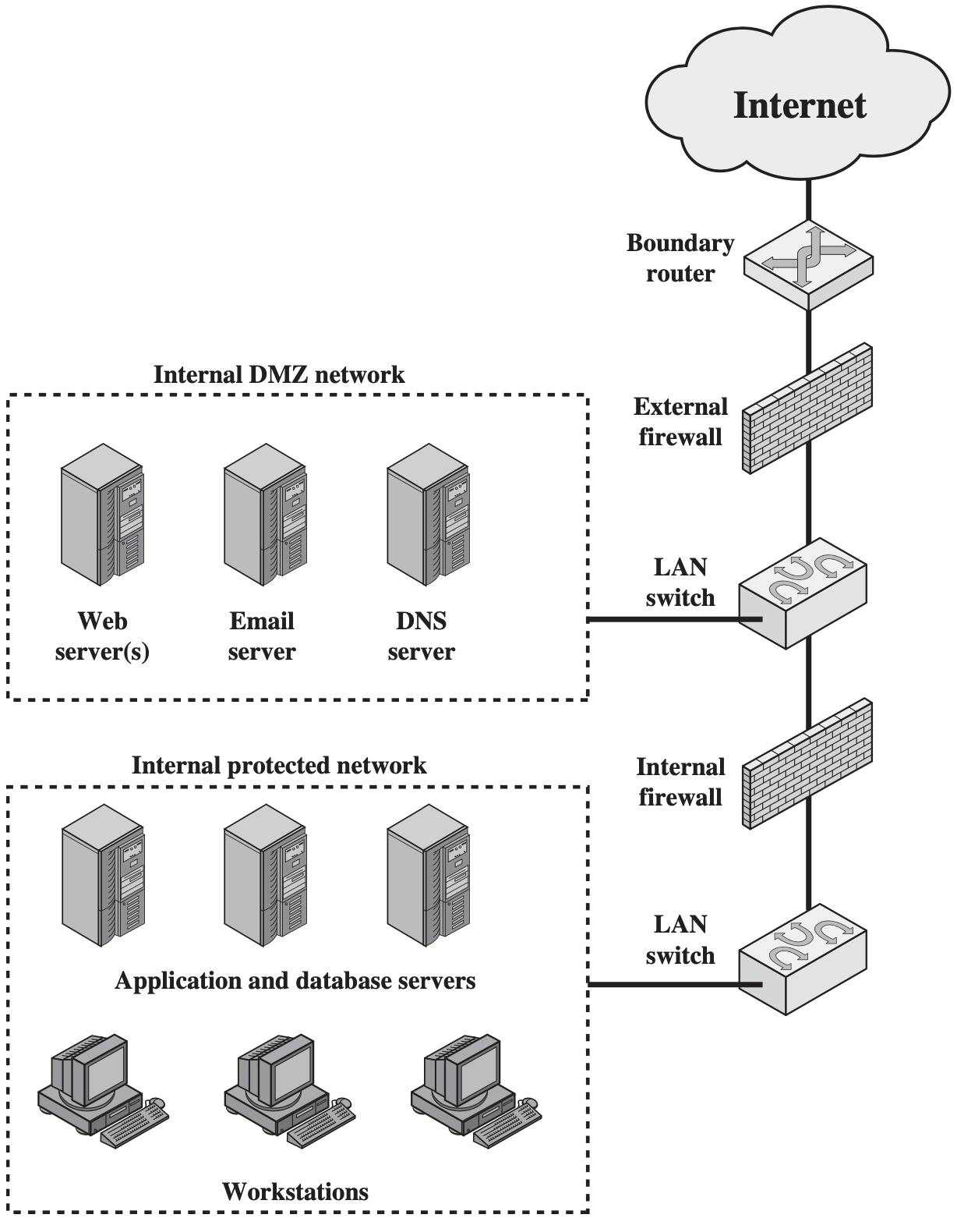
DMZ Networks
DeMilitarized Zone

Slide 25
DMZ Networks
External Firewall provide access control and protection for DMZ systems consistent with their need for external connectivity
Internal Firewall add more stringent filtering capability; protect internal network from attacks from DMZ and vice versa; protect internal networks from each other;

Slide 26
Virtual Private Networks
Use encryption and authentication in the lower protocol layers to provide a secure connection through the otherwise insecure Internet
Cheaper than real private networks using private lines
Common protocol in use: IPsec

Slide 27
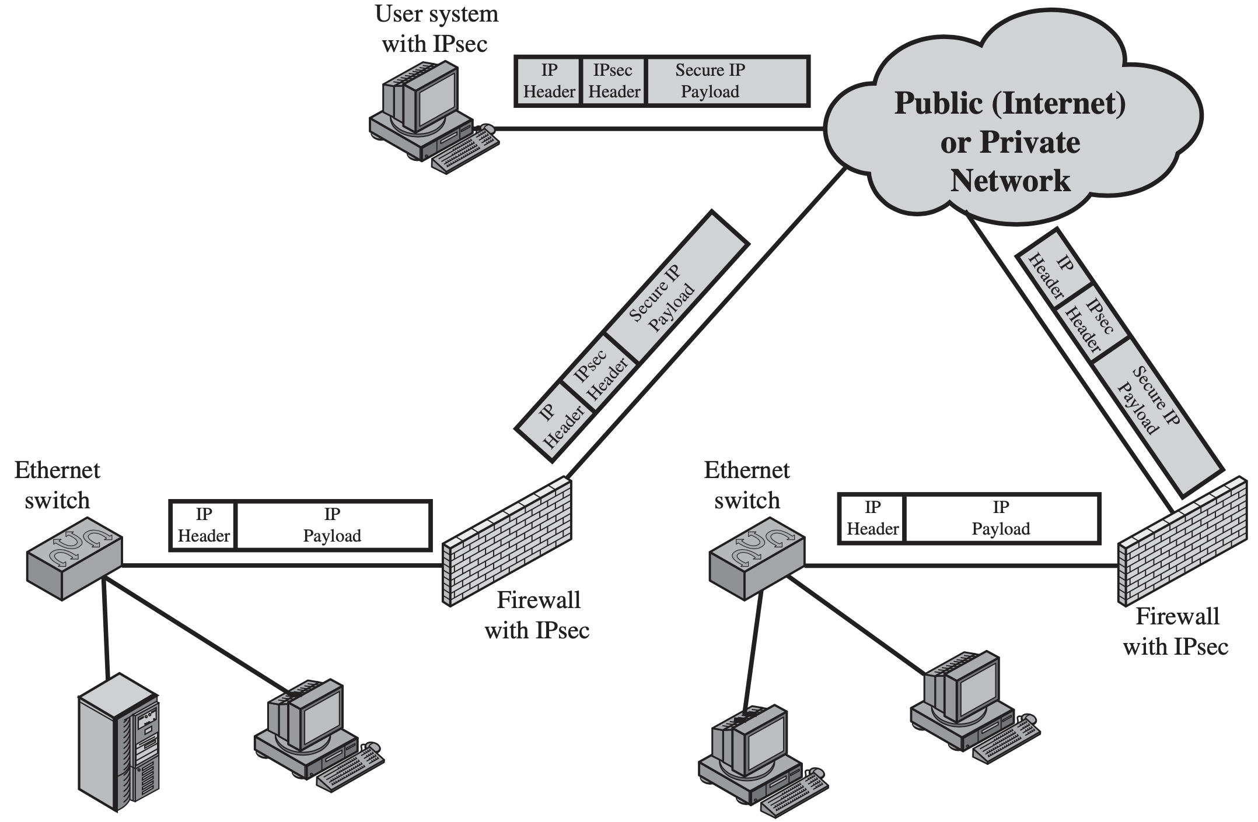
VPN

Slide 28
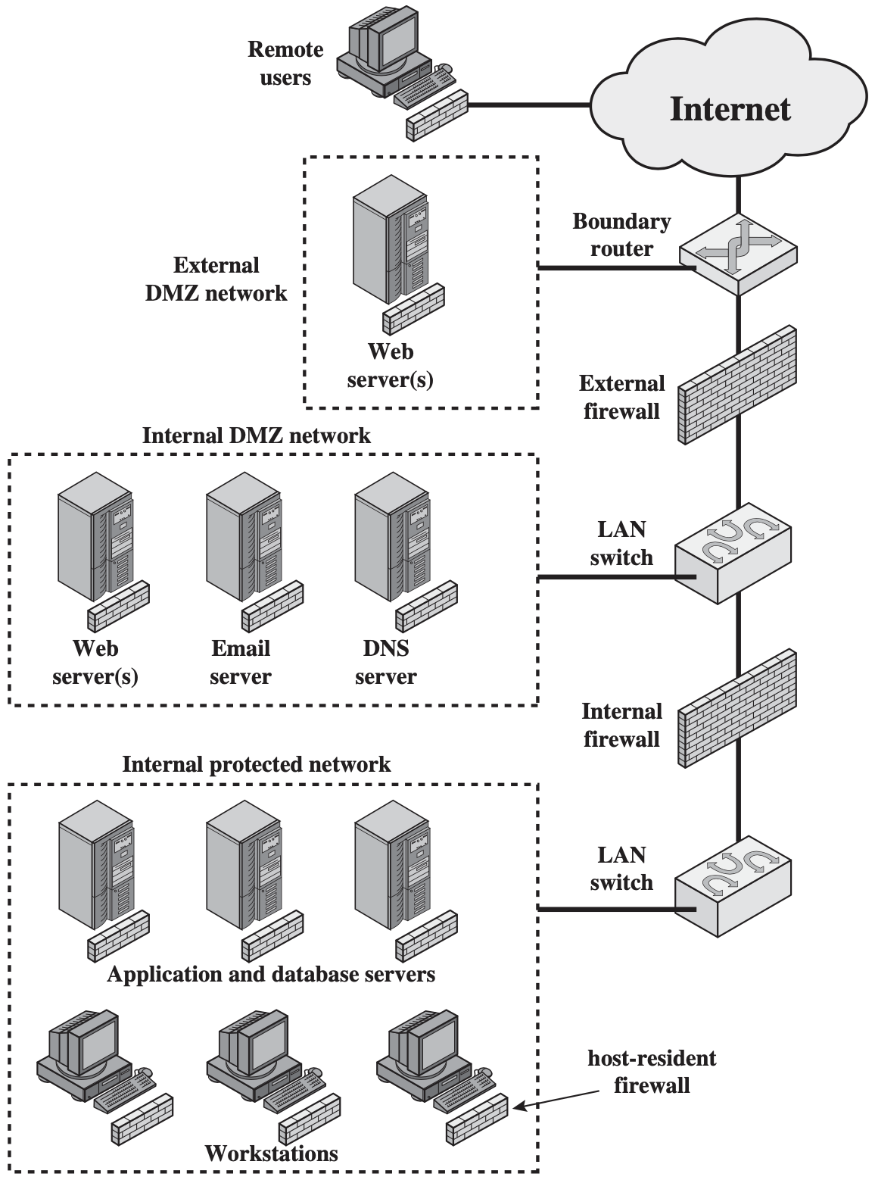
Distributed Firewalls
Stand-alone firewall devices plus host-based firewalls work together under a central administrative control

Slide 29
traffic pattern learned?
individually secure packets
yet collaboratively malicious

Slide 30
TCP SYN Flood
C
S
Single machine:
SYN packets with random source IP addresses
Fill up backlog queue on server
No further connections possible
SYN_{C1}
SYN_{C2}
SYN_{C3}
SYN_{C4}
SYN_{C5}

Slide 31
TCP SYN Flood
C
S
IP Spoofing:
SYN packets with random source IP addresses
Fill up backlog queue on server
No further connections possible
SYN_{C1}
SYN_{C2}
SYN_{C3}
SYN_{C4}
SYN_{C5}
Notes:
IP Spoofing: Craft SYN packets from randomly forged IP address;
For such random IP addresses, after they receive SYN ACK packets from the server, they may simply discard them as these IP addresses have not sent SYN requests at all

Slide 32
Intrusion Detection System

Slide 33
IDS
Detect unusual patterns of activity or patterns of activity that are known to correlate with intrusions
Provide early warning of an intrusion so that defensive action can be taken

Slide 34
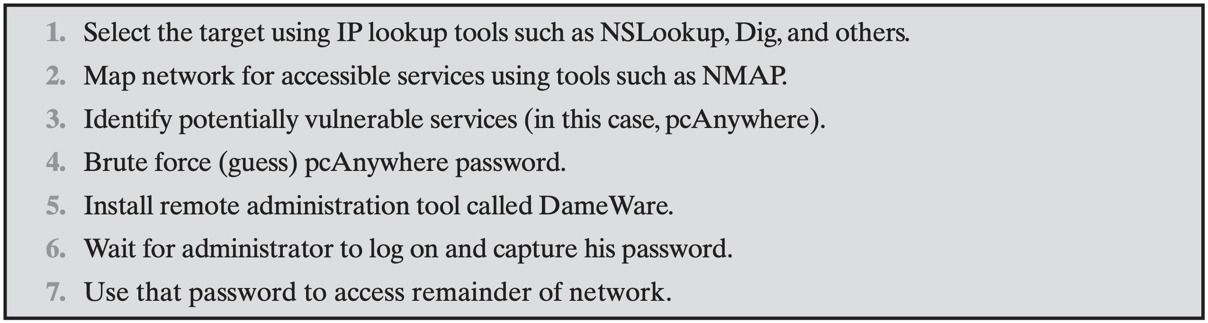
Intrusion Behavior Patterns
Hacker

Slide 35
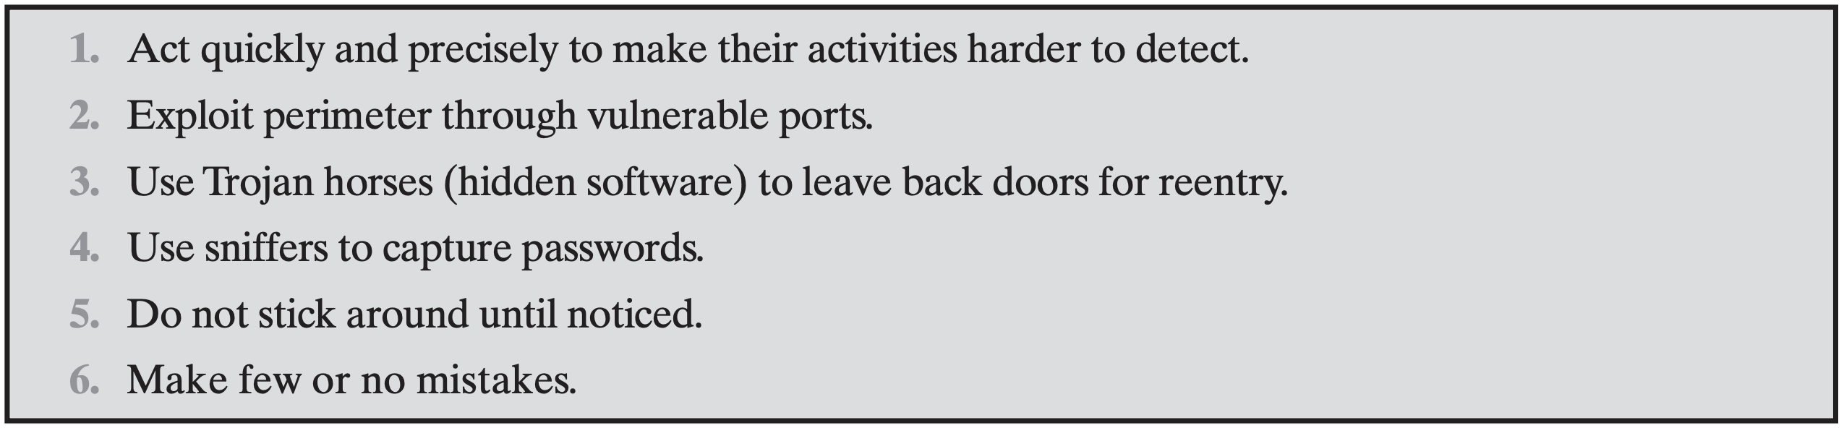
Intrusion Behavior Patterns
Criminal Enterprise

Slide 36
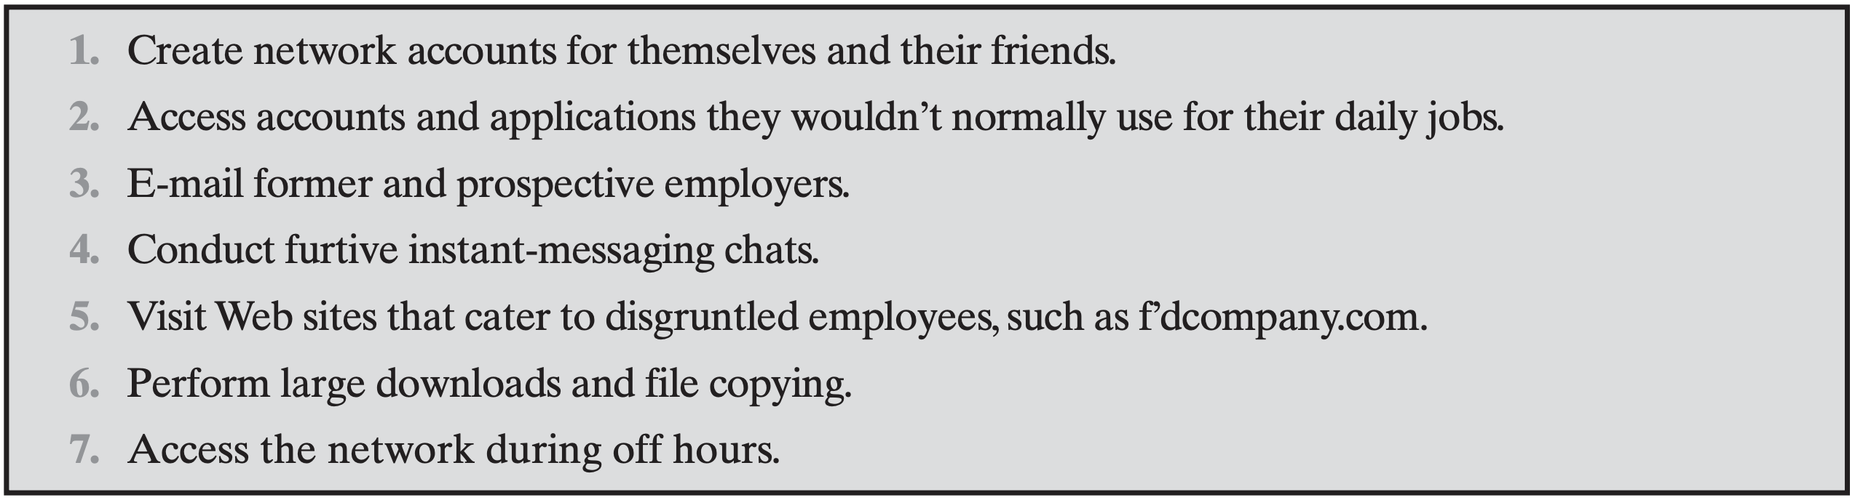
Intrusion Behavior Patterns
Internet Threat

Slide 37
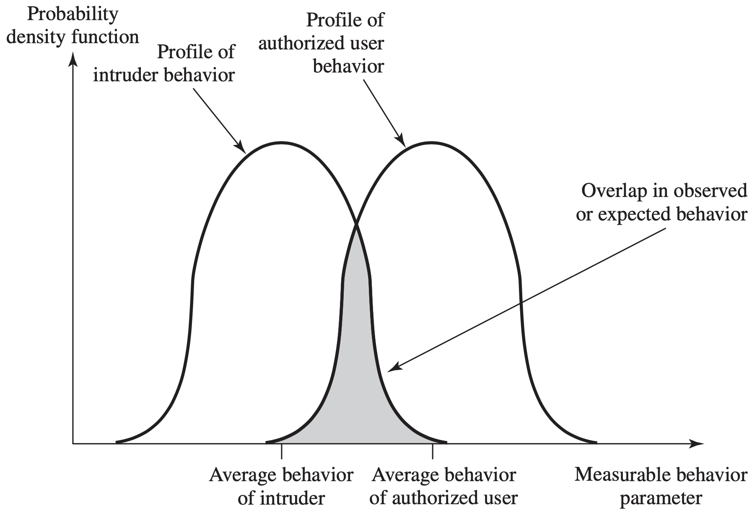
intruder behavior differs from that of a legitimate user in ways that can be quantified

Slide 38
how to detect intrusion?

Slide 39
Audit Record
Record ongoing activity of users
Input records to IDS
Native Audit Record
Detection-Specific Audit Record

Slide 40
Audit Record
Native Audit Record use available accounting software in OS to collect user activity information; need no additional collection software; may not contain needed information or may not contain it in a convenient form;

Slide 41
Audit Record
Detection-Specific Audit Record use a dedicated facility to generate audit records containing only required information for IDS; vender independent and portable; extra overhead;

Slide 42
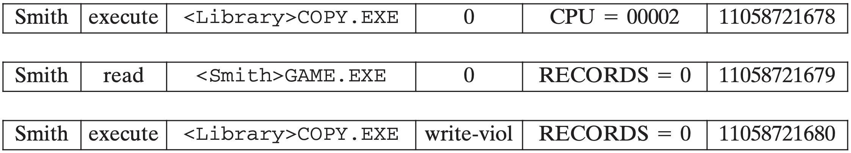
Audit Record
Example fields: Subject, Action, Object Exception Condition Resource-Usage Time-Stamp
Notes:
A good example of detection-specific audit records is one developed by Dorothy Denning [DENN87]. Each audit record contains the following fields:
Subject: Initiators of actions. A subject is typically a terminal user but might also be a process acting on behalf of users or groups of users. All activity arises through commands issued by subjects. Subjects may be grouped into different access classes, and these classes may overlap.
Action:Operationperformedbythesubjectonorwithanobject;forexample, login, read, perform I/O, execute.
Object: Receptors of actions. Examples include files, programs, messages, records, terminals, printers, and user- or program-created structures. When a subject is the recipient of an action, such as electronic mail, then that subject is considered an object. Objects may be grouped by type. Object granularity may vary by object type and by environment. For example, database actions may be audited for the database as a whole or at the record level.
Exception-Condition: Denotes which, if any, exception condition is raised on return.
Resource-Usage: A list of quantitative elements in which each element gives the amount used of some resource (e.g., number of lines printed or displayed, number of records read or written, processor time, I/O units used, session elapsed time).
Time-Stamp: Unique time-and-date stamp identifying when the action took place.

Slide 43
Statistical Anomaly Detection
Threshold detection count the number of occurences of a specific event type over an interval of time, detect an intrusion if the number exceeds a reasonable number
Profile-based detection (Signature) Characterize past behavior of some user(s), detect an intrusion if a significant deviation occurs

Slide 44
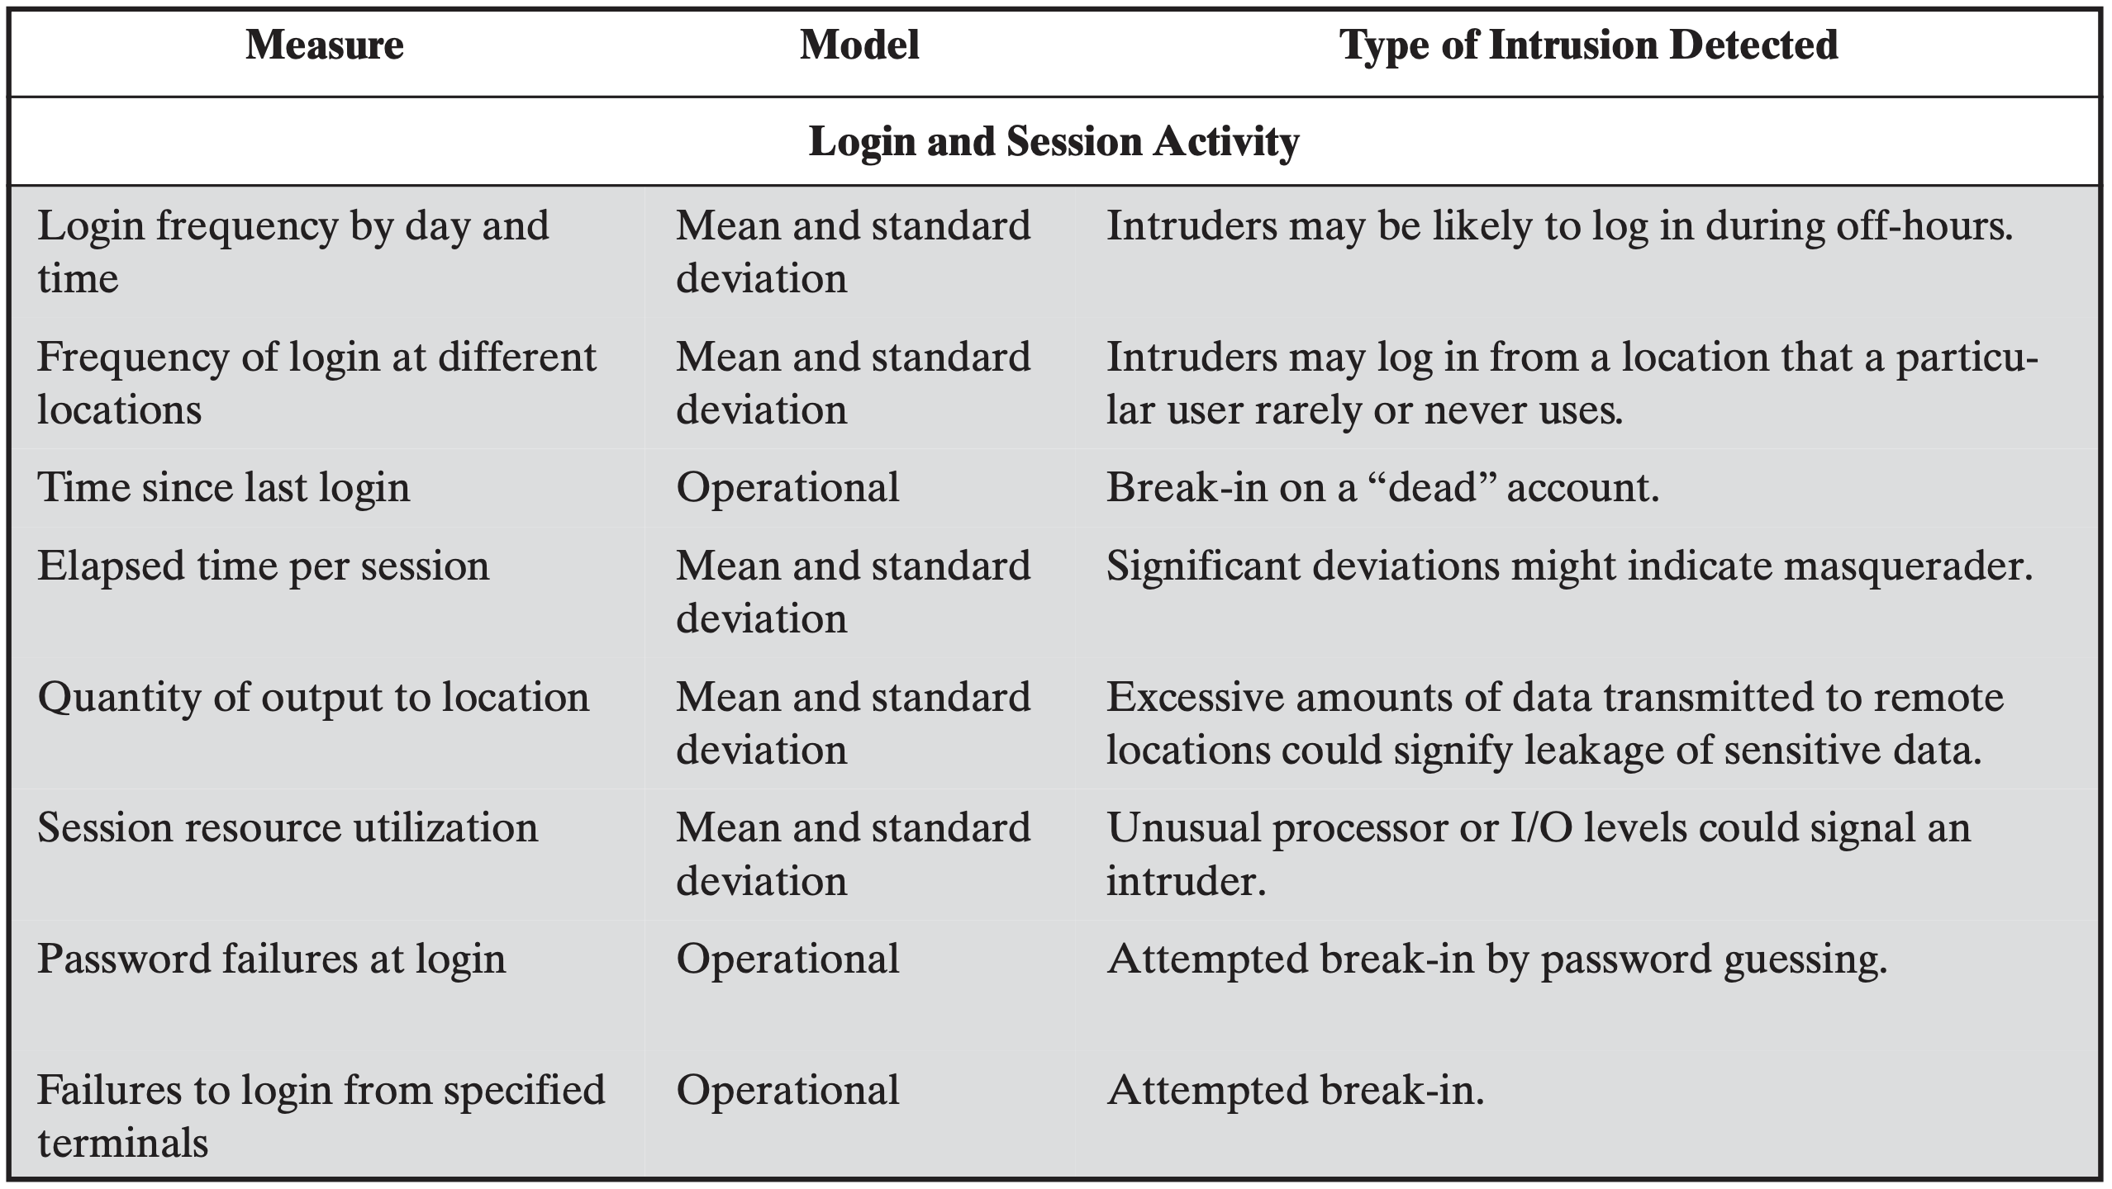
Statistical Anomaly Detection

Slide 45
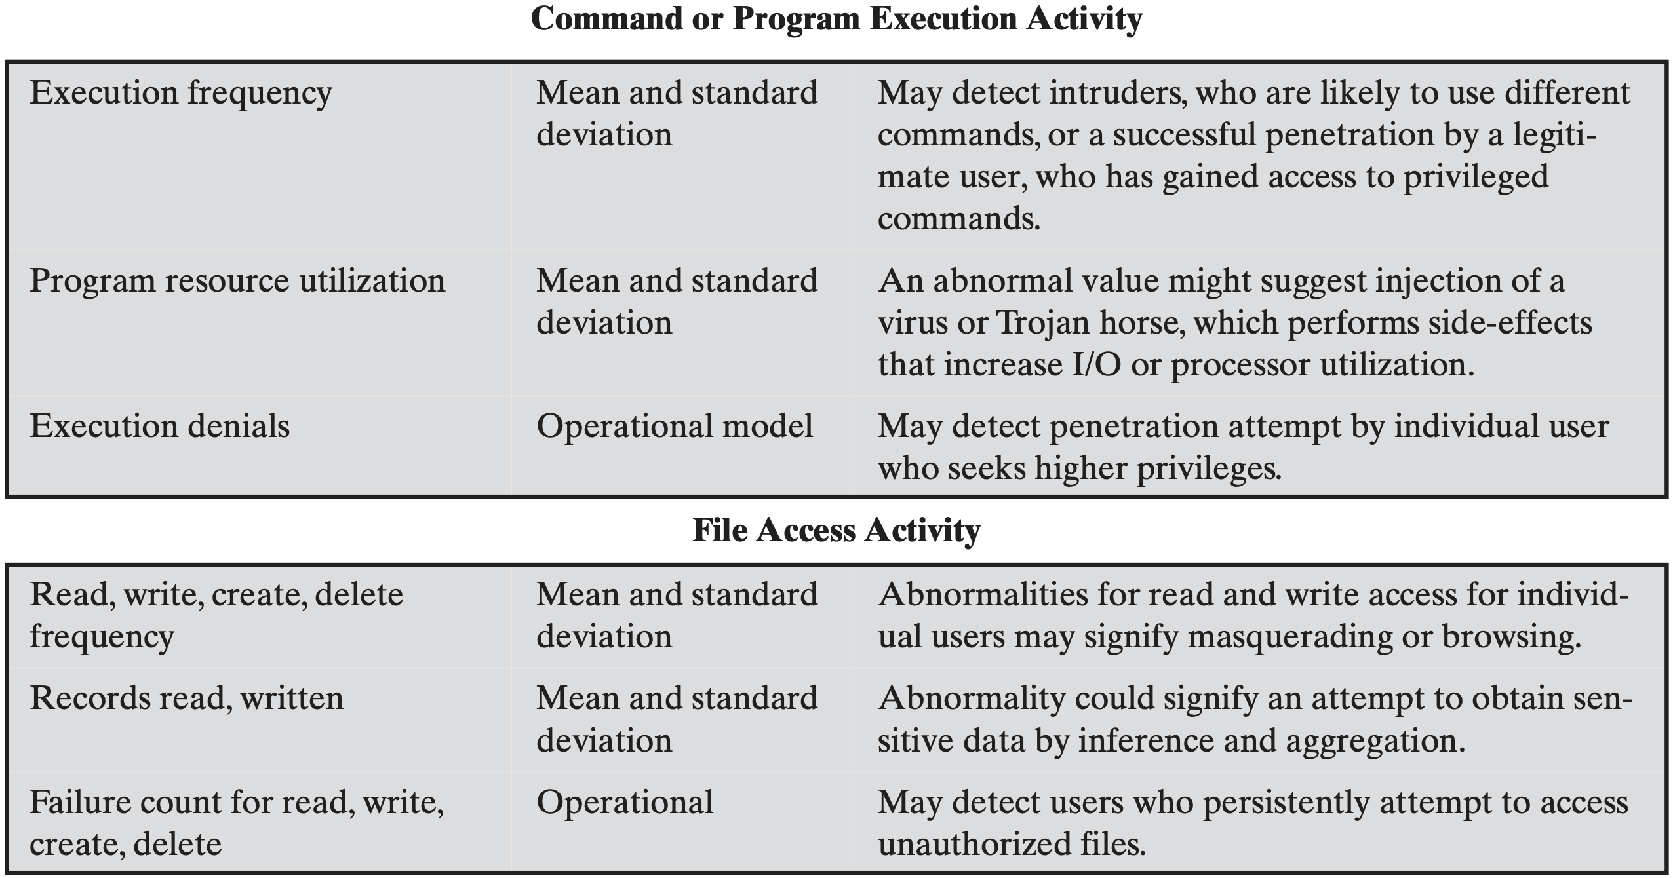
Statistical Anomaly Detection

Slide 46
Rule-Based Detection
Detect intrusion by observing events in the system and applying a set of rules that lead to a decision regarding whether a given pattern of activity is suspicious or not
Analyze historical audit records to identify usage patterns and generate rules that describe those patterns

Slide 47
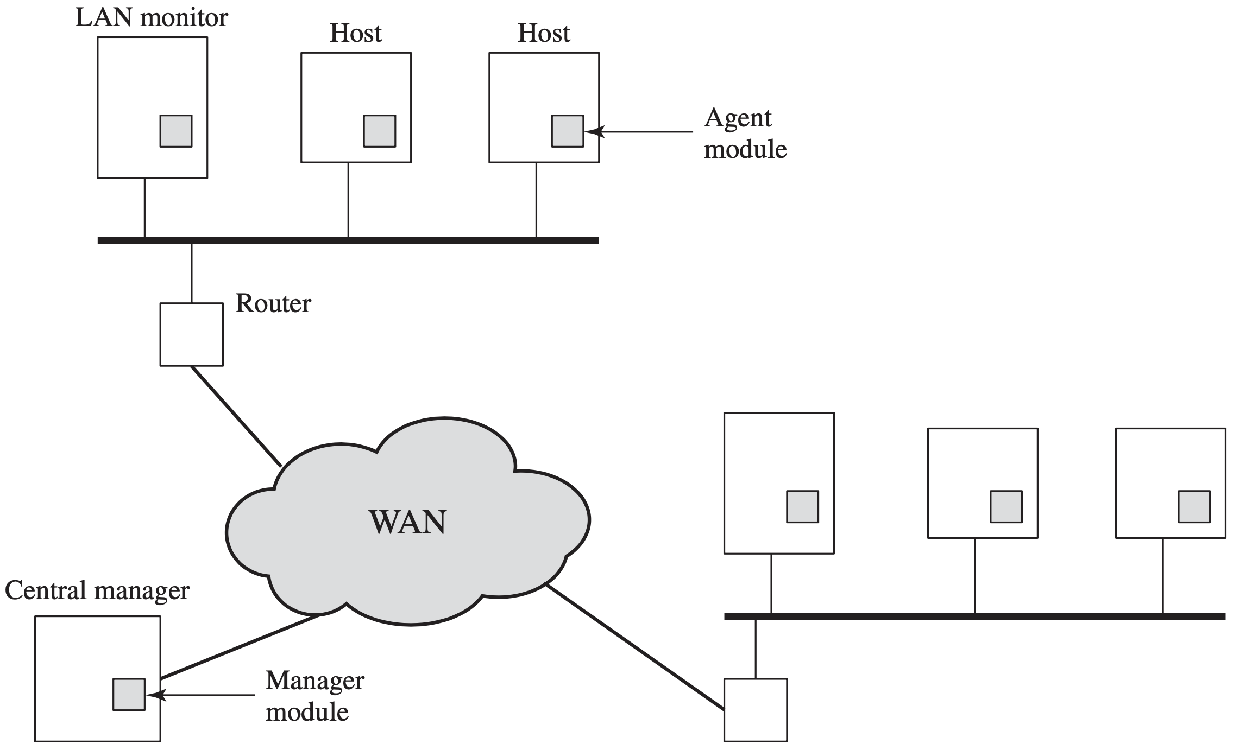
Distributed IDS

Slide 48
Distributed IDS
operate as a background process on a monitored system;
collect data on security-related events on the host and transmit to central manager;

Slide 49
Distributed IDS
operate the same as host agent module except that it analyzes LAN traffic and reports to central manager;

Slide 50
Distributed IDS
receive reports from LAN monitor and host agents, process and correlate these report to detect intrusion;

Slide 51
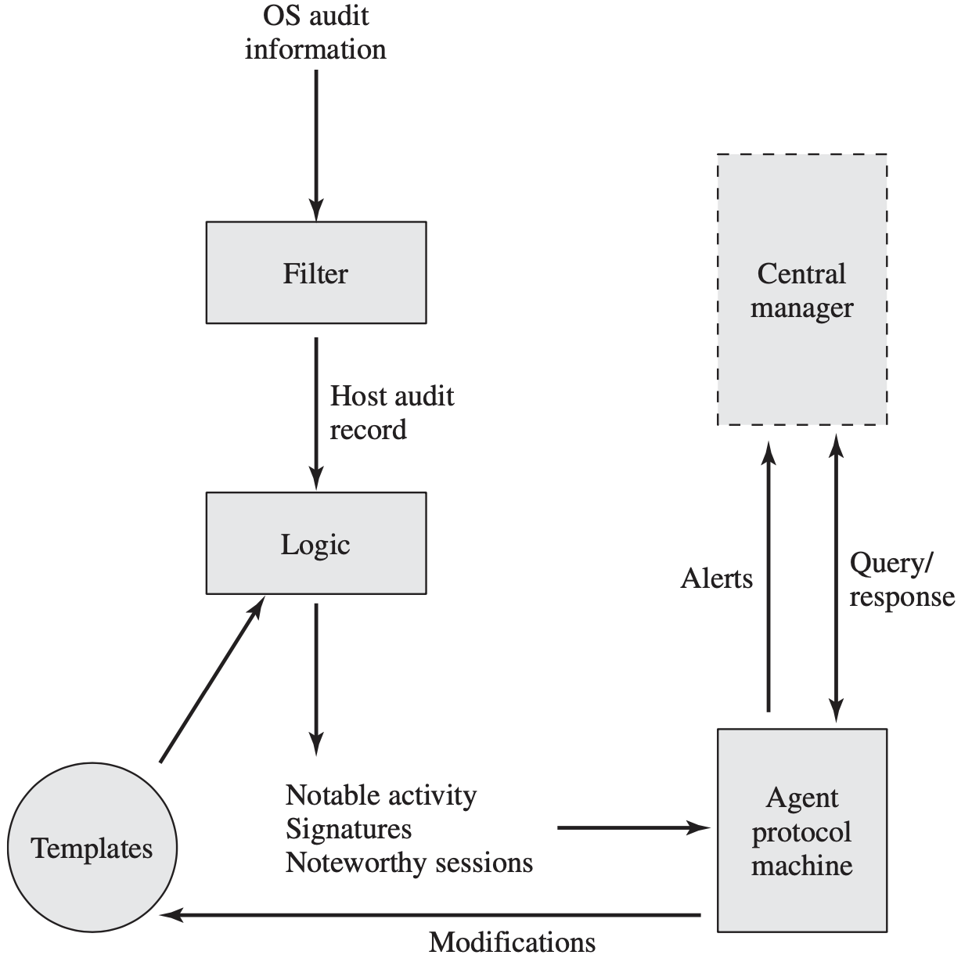
Agent Architecture
Notes:
Figure 20.3 [SNAP91] shows the general approach that is taken. The agent captures each audit record produced by the native audit collection system. A filter is applied that retains only those records that are of security interest. These records are then reformatted into a standardized format referred to as the host audit record (HAR). Next, a template-driven logic module analyzes the records for suspicious activity. At the lowest level, the agent scans for notable events that are of interest independent of any past events. Examples include failed file accesses, accessing system files, and changing a file’s access control. At the next higher level, the agent looks for sequences of events, such as known attack patterns (signatures). Finally, the agent looks for anomalous behavior of an individual user based on a historical profile of that user, such as number of programs executed, number of files accessed, and the like.
When suspicious activity is detected, an alert is sent to the central manager. The central manager includes an expert system that can draw inferences from received data. The manager may also query individual systems for copies of HARs to correlate with those from other agents.
The LAN monitor agent also supplies information to the central manager. The LAN monitor agent audits host-host connections, services used, and volume of traffic. It searches for significant events, such as sudden changes in network load, the use of security-related services, and network activities such as rlogin.

Slide 52
how to profile attack more?

Slide 53
Honeypot
Decoy systems designed to lure a potential attacker away from critical systems
Collect information about the attacker’s activity
Encourage the attacker to stay on the system long enough for administrators to respond

Slide 54
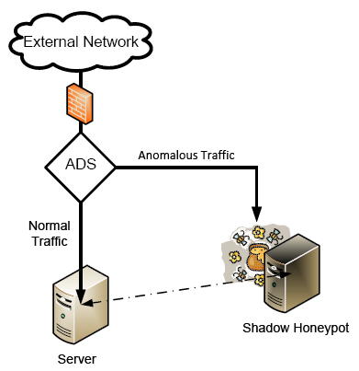
Honeypot
Decoy systems designed to lure a potential attacker away from critical systems
Collect information about the attacker’s activity
https://www.cse.wustl.edu/~jain/cse571-09/ftp/honey/

Slide 55
how accurate is IDS?

Slide 56
IDS Detection Accuracy
Detection rate / True Positive Rate (TP) given that there is an intrusion, how likely will the IDS correctly output an alert
False Negative Rate: FN = 1 - TP

Slide 57
IDS Detection Accuracy
False Alarm / False Positive Rate (FP) given that there is no intrusion, how likely is the IDS to falsely output an alert
True Negative Rate: TN = 1 - FP

Slide 58
IDS vs Firewall
Firewall supports active filtering
IDS provides only passive monitoring

Slide 59
an IDS that filters attack?

Slide 60
IPS
Intrusion Prevention System an extension of IDS to attempt to block or prevent detected malicious activity
Host-based, network-based, or distributed

Slide 61
IPS
Anomaly detection to identify behavior different from legitimate users
Signature/heuristic detection to identify malicious behavior

Slide 62
advanced traffic analysis?

Slide 63
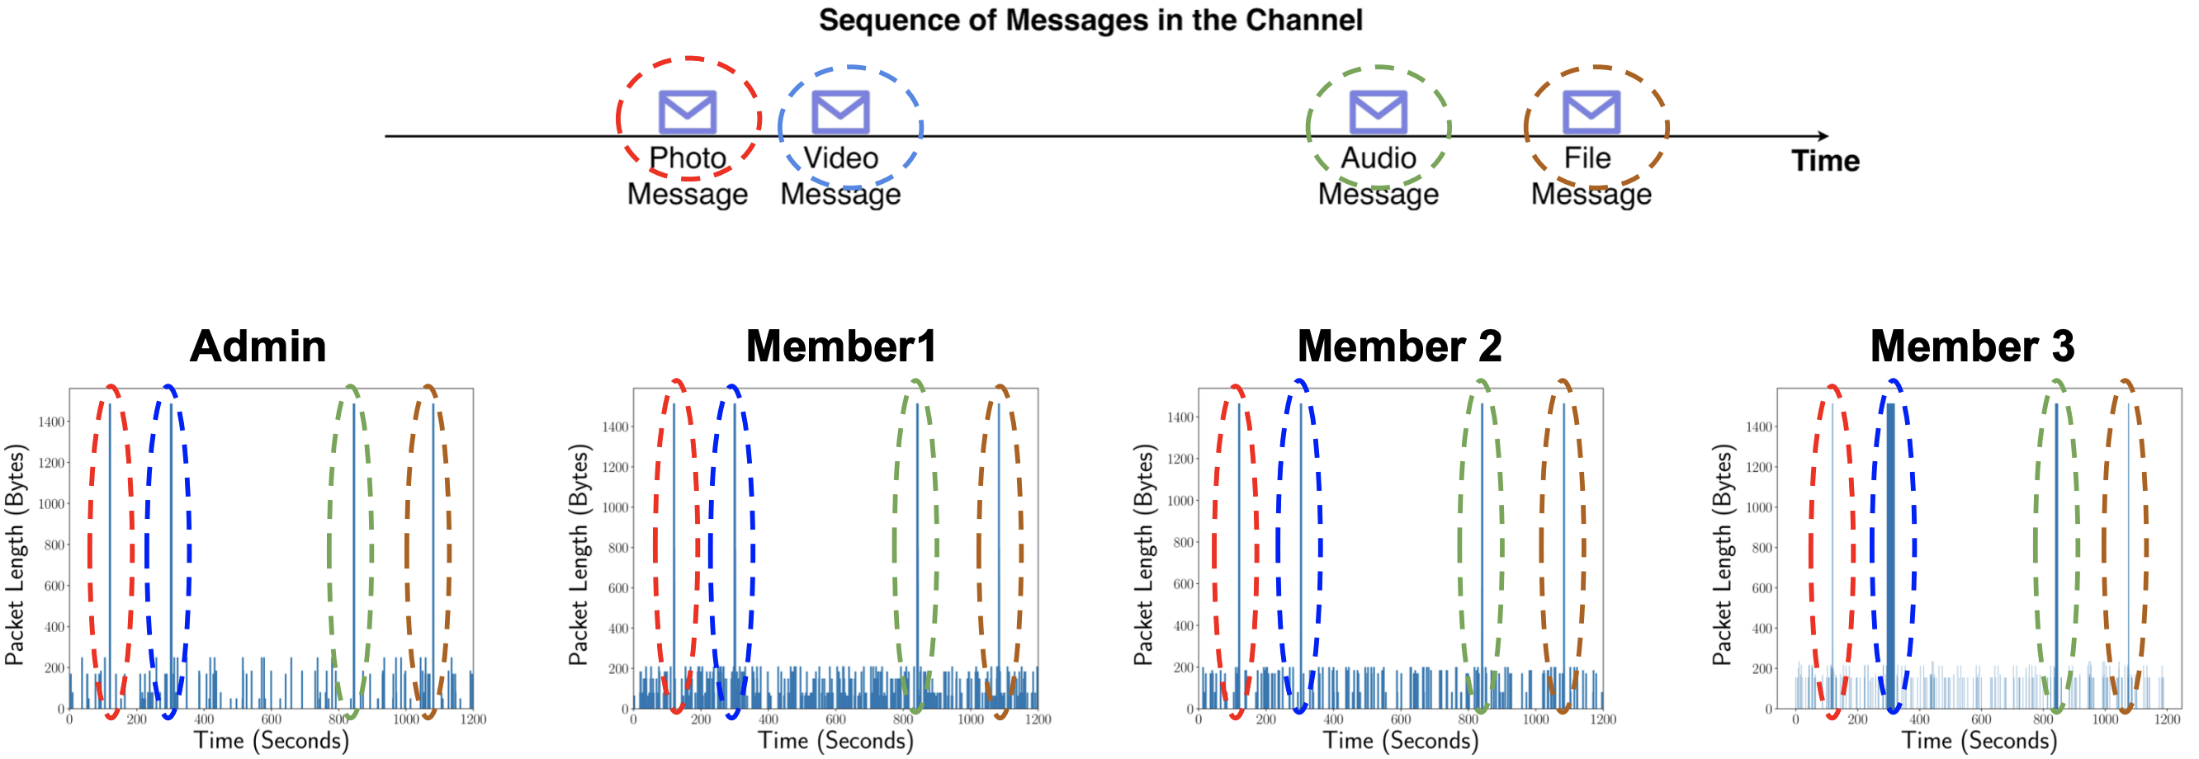
Pattern Correlation
Pair users of secure messaging applications
https://www.ndss-symposium.org/ndss-paper/practical-traffic-analysis-attacks-on-secure-messaging-applications/

Slide 64
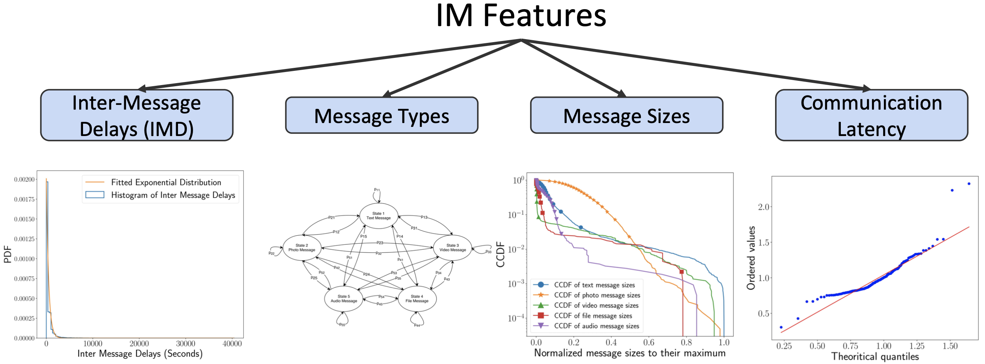
Pattern Correlation
Secure messaging applications’ traffic features
https://www.ndss-symposium.org/ndss-paper/practical-traffic-analysis-attacks-on-secure-messaging-applications/

Slide 65
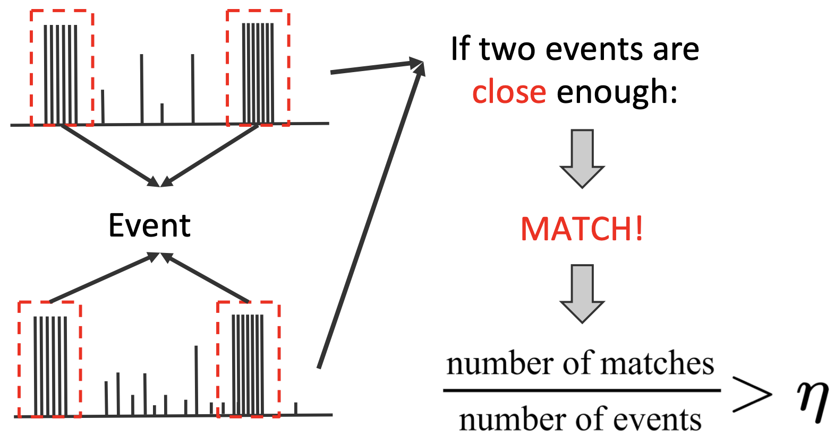
Pattern Correlation
event-based algorithm
https://www.ndss-symposium.org/ndss-paper/practical-traffic-analysis-attacks-on-secure-messaging-applications/

Slide 66
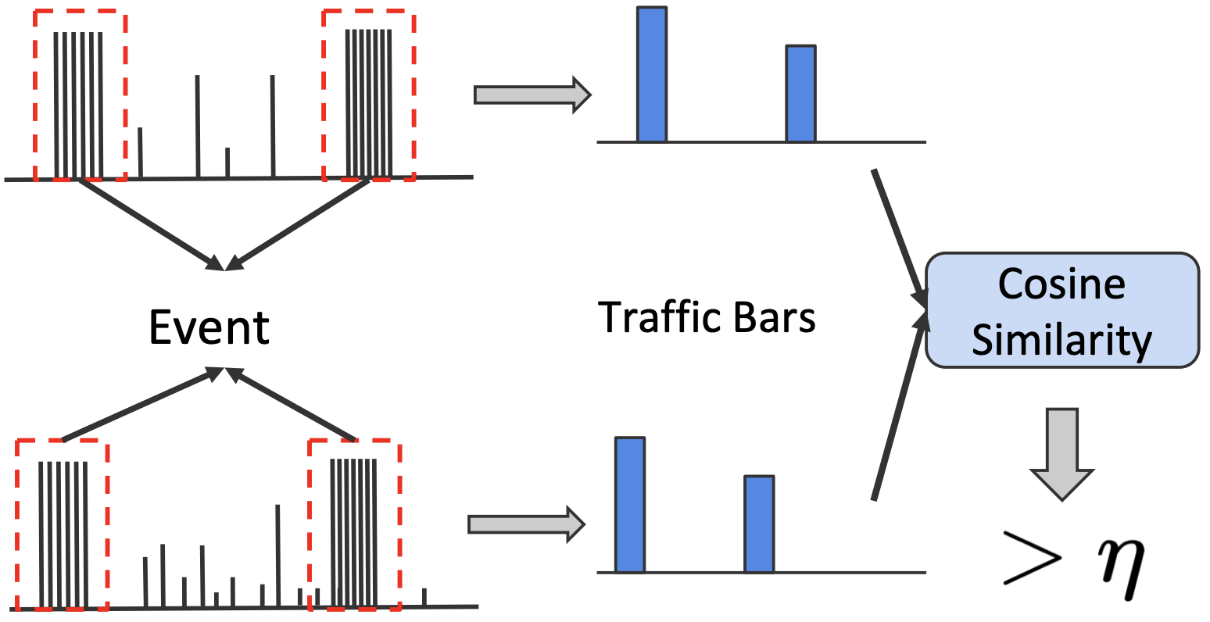
Pattern Correlation
shape-based algorithm
https://www.ndss-symposium.org/ndss-paper/practical-traffic-analysis-attacks-on-secure-messaging-applications/

Slide 67
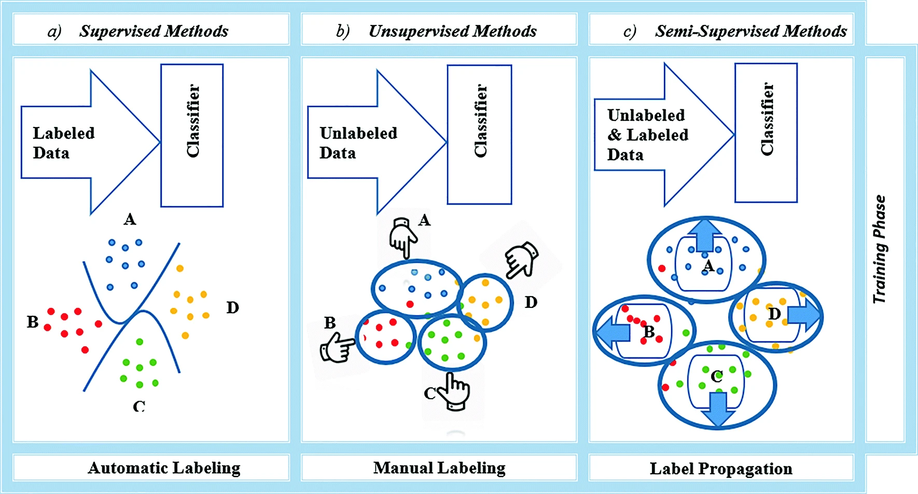
Learning…for sure
Machine learning
Deep learning
https://link.springer.com/article/10.1007/s12243-020-00770-7

Slide 68
how to evade analysis?

Slide 69
hide traffic pattern

Slide 70
Traffic Obfuscation
Encrypt traffic to hide payloads
Use proxy to hide entire packets
Introduce noise traffic to hide patterns

Slide 71
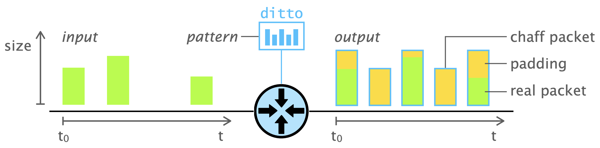
ditto
Obfuscate packet size by padding
Obfuscate transmission interval by dummy packets
https://www.roland-meier.ch/files/roland-meier_ditto_ndss22.pdf

Slide 72
how to detect evasion?

Slide 73
more advanced analysis

Slide 74
Active Probing
Suspicious of a host using malicious software?

Slide 75
Active Probing
Suspicious of a host using a certain software (e.g., cryptomining)?
Send a probe (e.g., to a specific port) under the protocol of the software
See if the probed host responds as expected

Slide 76
more ideas?

Slide 77
?

Slide 78
Readings
Cryptography and Network Security: Principles and Practice
by William Stallings
Chapter 20: Intruders
Chapter 22: Firewalls
IDS vs IPS vs Firewall – Know the Difference
by Rashmi Bhardwaj

Slide 79
Thank You
be on the road
Notes:
Run your own race.

